Slide 1
Baptism
What does it mean?
Gk. baptizō
derived from Gk. baptō – to
dip or dye
- Thayer’s ‘Lexicon’

Slide 2
Baptism
In English, -ize is added to adjectives and nouns to form transitive verbs with the general senses “to render, make” (actualize; fossilize; sterilize; Americanize), “to convert into, give a specified character or form to” (computerize; dramatize; itemize; motorize), “to subject to (as a process, sometimes named after its originator)” (hospitalize; terrorize; galvanize; oxidize; simonize; winterize).
Also formed with -ize are a more heterogeneous group of verbs, usually intransitive, denoting a change of state (crystallize), kinds or instances of behavior (apologize; moralize; tyrannize), or activities (economize; philosophize; theorize).
dictionary.reference.com
Notes:
1. Definition - So baptize can be seen as subjecting to a process of dipping (dyeing).

Slide 3
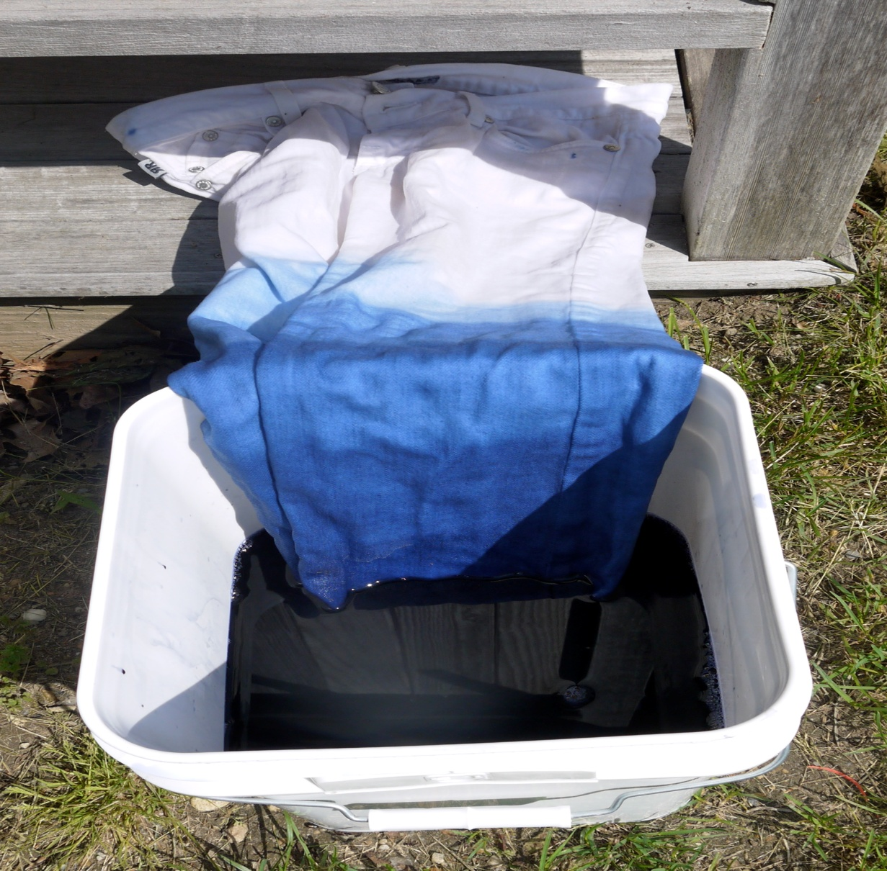
Baptism
Notes:
1. NOTE – in dyeing, an object takes on a characteristic of the medium in which it is dipped

Slide 4
Baptism
Where is it found?
verb baptizō – 2 OT, 77 NT
verb baptō – 16 OT, 6 NT
(embaptō -2)
noun baptismos – 4 NT
noun baptisma – 19 NT
noun baptistēs – 12 NT
Notes:
Moulton & Milligan - make distinction that baptisma was coined by NT writers – distinguished from baptismos already in use (found in Josephus)
Hebrew Equivalent – tâbal – 16 occs. OT, but Gen.37:31 included, Lev.11:32 excluded (opp. LXX).
Nouns – not in OT.
Interesting – that the “one baptisma” of Eph.4:5 balances the “baptismos” of co-burial, co-rising in Col.2:12

Slide 5
Baptism
1st instance of “dipping” –
Gen.37:31
Last instance – Rev.19:11-13
Notes:
Rev.19:11-13 – Some interpret the blood as the blood of His enemies, but He is not pictured at the wine-press of Rev.14:19-20. One must pull in Isa.63:1-5 “red garments of Bozrah” – but this treading of the wine-press yields a “polluted” or “defiled” garment. Is Jesus Christ returning in polluted garments? No, it is His own blood that makes this garment special – due to sacrificial dipping in blood, like the typology of Joseph’s coat of many colors.

Slide 6
Baptism
More OT dippings –
Exo.12:22
Lev.9:9
Lev.14:1-7, 49-51
Num.19:18
Heb.6:1-2; 9:9-10
Mar.7:1-5; Luk.11:37-39
Notes:
Exo.12:22 – Passover, dipping hyssop in lamb’s blood and sprinkling lintel and side-posts – the sign of blood to avoid the 10th plague: Death
Lev.9:9 – Aaron dipped his finger in the blood of atonement (i.e., “covering”) and applied to the horns of the altar
Lev.14 – “the Law of the Leprous” – its cleansing. Leprosy as a metaphor for the spiritual state of being cut off from God’s congregation. NB: cleansing leprosy was 1 of the 6 signs that Jesus told John’s agents to report to him. Lepers/Leprosy are mentioned 13 times in the Gospels – 12 times relating to Jews/Samaritans, 1 a ref. back to Naaman the Syrian.
Num.19:18 – cleansing a person, tent or open vessels from contact with a corpse
Heb. – a backward glance at these “regulations”
Mar.7:3-4 – OT washings exacerbated by “the elders”
Luk.11:37-39 – “washed” = baptized (baptizō)

Slide 7
Baptism
Best viewed as having –
A Goal (into what?)
2. An Agency (in or with what?)

Slide 8
Baptism
A typical baptism – 1 Pet.3:20-
21; 2 Pet.2:5; 3:5-7
A “parabolic” baptism – 1 Cor.
10:1-4
Baptism of John – Mat.3:5-6;
Joh.1:22-37; Acts 19:1-6; Joh.4:1-2
Cp. Eisodus – Jos.3:15-17
Notes:
Overthrow Baptism – Goal: reclamation of earth for God’s plan – a creature made of earth; Agency: a great flood of waters
Noah’s Baptism – Goal: salvation of 8 righteous souls; Agency: a great flood of waters. Noah typically died (in the Ark) and rose again when he stepped out onto dry ground. The sign of Noahic covenant – God’s bow in the cloud. The Antitype – Goal: salvation & answer of a good conscience to God; Agency: the resurrection of Jesus Christ
2 Pet.3:5-7 – NB: 2 typical baptisms of the earth – 1st with water, 2nd with fire
Exodus & Wilderness – Goal: “into Moses” the deliverer-saviour; Agency: by the cloud and the sea. Psa.77:17 – “dark clouds” were over the Red Sea crossing.
John’ Baptism – Goal: “into the baptism of John” the great antitype of Elijah the converter of hearts (Mal.4:5-6), for repentance; Agency: waters of the Jordan. NB (Mat.3:6): part of their conversion included “confessing their sins”. NB: impact of John’s mission lasted years!
John’s Baptism – was also preparation for the Nation of Priests, per Exo.29:4
Joh.1:22-37 – John explains WHY he baptized. He may have “known Him not” until the manifestation, but he did know beforehand that One Mightier then he would come (Mat.3:11; Mar.1:7-8; Luk.3:16).
Eisodus - John came baptizing in the desert (Mar.1:4), like the priests with Ark of the Covenant – they dipped their feet in the flood waters of the Jordan, but stood on dry ground (Jos.3:15).

Slide 9
Baptism
Contrast 2 baptisms – Mat.3:10-12
Why Jesus? – Mar.1:9
The New Baptism – the mightier
baptism – Acts 1:5; 2:1-4, 16-21,
37-38
Why did water baptism continue
into Acts?
Notes:
2 Baptisms of Israel - water vs. holy spirit and fire – old vs. new.
Why Jesus? – He came not to destroy the old (Law), but to confirm it (Mat.5:17). NB: He was baptized “into the Jordan” (Goal), identifying Him with crossing Jordan – as John/Moses so Jesus/Joshua. NB: John baptized “beyond Jordan” (Joh.1:28; 3:26; 10:40). After His baptism in water by John, the Spirit descended upon Him from the Father.
New Baptism – described simply in Joh.1:33 as “with holy spirit” and with greater detail as “with holy spirit and fire” (Mat.3:11; Luk.3:16). NB: not “with holy spirit and with fire” – it’s one agency, not two.
Acts 2:38 –it’s still a water (Agency) baptism of repentance, like John’s, but it’s now “upon (or into) the name of Jesus Christ unto forgiveness” (Goal). This was a continuation of John’s baptism for “this side of Jordan”. NB: it was REQUIRED of believing (i.e., repentant) Jews. NB: it was a pre-condition to spirit baptism.
Why did water baptism continue? – a) “to fulfill all righteousness”; b) Old Covenant was vanishing away, but not gone yet (Heb.8:13).

Slide 10
Baptism
Still 2 baptisms – Acts 8:14-17
Once the “spirit” preceded the
“water” – Acts 10:44-48
Higher significance – spiritual
identification – Rom.6:2-8;
Gal.3:26-28
Notes:
Spirit preceded Water: water was added by Peter, after the Greater Baptism had been given by the Holy Spirit. The water was superfluous, ritualistic and unnecessary for Gentiles. NB: It did NOT become part of the legal requirements laid upon believing Gentiles by the Acts 15 council – Ac.15:19-20. Cp. Peter’s rush to add “hands and head” to the need to have his feet washed (Joh.13:9). As far as we know, these were the ONLY Gentiles water-baptized during Acts.
Identification – Spiritually “dyed” with the character of Christ by the agency of the Spirit. Rom.6:3-8 - “into Christ Jesus” “into His death” “buried with Him” (Goal) – this was accompanied by the WATER during Acts – for Jews mainly!
Identification - Gal.3:26-28 “into Christ” = “putting on Christ” as a garment dipped in His blood – cp. Rev.7:13-14.; 1:5. NB: this includes Greeks, for whom water baptism was not required.

Slide 11
Baptism
Hand laying -
Substitutionary sacrifice – Exo.29:10 (17 occs.)
Judgment – Lev.24:14
Identification and offering – Num.8:5-16
Transfer of authority – Num.27:15-23;
Deu.34:9
Yahweh conferring strength - Psa.37:23-24
Notes:
With Deu.34:9 – cp. Isa.11:1-5 and the “spirit of wisdom” – Messianic & Millennial

Slide 12
Baptism
Hand laying -
Raising the dead - Mat.9:18
Healing – Mar.6:5; 8:23, 25 (double); Acts 28:8
Conferring blessing – Mat.19:15
Receipt of holy spirit - Acts 8:17
Commissioning Barnabas & Saul – Acts 13:1-3
Appointing elders – 1 Tim.5:22, 24
Notes:
Mat.9:18 – note that it was the expectation of a “ruler” that Jesus’ hand laying would raise the dead
1 Tim.5:22 – note difference with Acts period – agency of the Holy Spirit - Acts 20:17, 28

Slide 13
Baptism
A “spirit” baptism – 1 Cor.12:12-13
Another spiritual analogy –
Heb.10:22
The significance of the “fire” –
Mar.9:49; Luk.12:49-50
The Great Commission – Mat.28:18-20
Notes:
1 Cor.12:12-13 – “Baptized by one spirit” (Agency) = “drink one spirit”. “Into one body” (Goal). Relates to 1 Cor.10:3-4 where Israel in the wilderness “all drank the same spiritual drink” – they were also treated by Yahweh as one body.
Heb.10:22 – “hearts sprinkled”, but body bathed (louō) “with pure water”
Fire – context of Mat.3:7-12 shows a fiery aspect of the premillennial judgment – the declaration of a spirit/fire baptism is ringed with fire, as it were.
Mar.9:49 – fiery trial for the righteous (1 Pet.1:6-7); destruction for the wicked (Gehenna, furnace of fire, lake of fire, etc.). Read Mal.4:1-3 – NB: Acts was a foretaste; the greater fire is yet future.
Luk.12:49-50 – Jesus’ baptism of fire – to be shared by James and John (Mar.10:35-40) – or was it postponed?
Great Commission – Goal: “into the name of the Father and the Son and the Holy Spirit” to make disciples of the nations. Postponed - fulfillment is yet future.

Slide 14
Baptism
An OT Significance of Water Baptism:
Preparation of Aaronites for
priesthood – Exo.29:1-9; 40:12-16
The larger priesthood – Exo.19:3-14;
23:22 (LXX); Isa.61:1-9; 1 Pe.2:1-10
(1:1 – Peter addressed the “diaspora”);
Ro.15:16; Heb.10:19-22; Re.1:5-6;
5:6-10; 20:4-6
Notes:
Recall Joh.1:25 – “Why, then, do you baptize, if you are not the Christ, nor Elijah, nor the prophet?” – question from Pharisaic priests and Levites. They appeared to understand the role of baptism exercised by one with proper authority.

Slide 15
Baptism
What is the “one baptism”?
Eph.4:3-6 – “the unity of the Spirit”
one body
one spirit
one hope …
one Lord
one faith
one baptism (hapax)
one God and Father of all …
Notes:
One Baptism – NB: we are to guard it as an aspect of the 7-fold “Unity of the Spirit”. It fits another aspect – “one body” of which Christ is said to Head.
The Unity of the Spirit – in the structure “one spirit” parallels “one baptism”. NB: it also includes “one body” – all three parts included in the spirit baptism of 1 Cor.12:12-13, but with no reference to “one” baptism.

Slide 16
Baptism
The Two “One Bodies”
1. 1 Cor.12:12-13 –
a) the Jew first, also the Greek –
Rom.1:16; 2:9-10
b) the Gentile graft contrary to nature –
Rom.11:11, 16-28
c) membership distinguished by spiritual gifts – evidential – 1 Cor.12:14-31
d) “a body of Christ” – 1 Cor.12:27
Notes:
C) – NB, no particular emphasis on headship of this body – a limited metaphor.

Slide 17
Baptism
The Two “One Bodies” (ctd.)
2. Eph.4:3 –
a) the both (Jew & Greek) “super-
reconciled” – Eph.2:13-19
b) a “joint-body” for the nations –
Eph.3:6
c) gifts for edifying “the body of the
Christ” – non-evidential – Eph.4:11-12
Notes:
A) – apokatalassō – new word, coined for a new relationship
B) – sussōmos – new word, coined for a new relationship

Slide 18
Baptism
The Two “One Bodies” (ctd.)
2. Eph.4:3 –
d) membership as “joint-partners”
– Eph.3:6
e) a further “super-reconciliation” –
the things “upon the earth and in
the heavens” – Col.1:20-22
f) Headship of Christ over this body (and heavenly powers) emphatic – Eph.1:22-23;
Col.1:18; 2:10
Notes:
D) – summetochos – only here and Eph.5:7 in the Gk. Bible

Slide 19
Baptism
Character of OUR spirit baptism?
a pledge of our inheritance –
Eph.1:13-14
wisdom & revelation in
acknowledgement of Christ – 1:17-18
Jew & Greek – access to the Father –
joint-citizens – householders 2:18-19
unity, peace – 4:3
Notes:
Spiritual Wisdom – with it we may begin to perceive our spiritual blessings in the heavenlies

Slide 20
Baptism
Character of OUR spirit baptism?
renewal, new man – Eph.4:23-24
help – Phi.1:19
standing fast – 1:27
fellowship – 2:1
service to God – 3:3
love – Col.1:8
wisdom & spiritual understanding – 1:9
Notes:
Spiritual Wisdom – with it we may begin to perceive our spiritual blessings in the heavenlies

Slide 21
Baptism
Parallels of spirit baptism:
Sealed by the Holy Spirit – Eph.1:13-
14; 2 Cor.1:20-22
Merged into Christ – Col.2:11-12;
Rom.6:2-6; Gal.3:27
Put on Christ – Eph.4:23-24; Gal.3:27
Notes:
Sealed – in both cases the “sealing” with the spirit is also an “earnest” of the full promise
Col.2:11-12 – shows our baptism to be one of spiritual identification with Christ (like Rom.6) – “buried together with Him” “raised together”. NB: being “crucified with Him” is absent – but being “dead to sin” remains for us (Eph.2:1,5; Col.2:13; 3:3)
Col.2:11-12 – a spiritual “circumcision of Christ” is mentioned only here, but cp. Phi.3:3 and Rom.2:26-29
Rom.6:2-8 – “baptized into His death” = buried with and raised with Him. “Died with Christ” and “will live with Him.” NB: additionally “our old man crucified together.”
Eph.4:23-24 – “renewed by the spirit of your mind” = “put on the new man … created in righteousness and holiness of truth”.
Gal.3:27 – “baptized into Christ” = “put on Christ”.

Slide 22
Baptism
Steps of spiritual identification:
Crucified with – Rom.6:6; Gal.2:20
Suffer with – Rom.8:17-18; (Phi.3:10)
Died with – Rom.6:8; Col.2:20; 2 Ti.2:11
Buried with – Rom.6:4^{b}; Col.2:12^{b}
Made alive with – Eph.2:5; Col.2:13
Raised with – Eph.2:6; Col.2:12^{b}; 3:1
Notes:
Suffer with – the walk consequent upon baptism was to “suffer with Him” (Rom.8:17-18). This has its analogy with Phi.3:10 – “the fellowship of His sufferings”.
Died with – synonymous with “planted together in likeness of His death…of His resurrection” (Rom.6:5) – cp. “conformed into His death” (summorphizō – Phi.3:21)
Raised with – circumlocution in Rom.6:4
Superscript b –identifications explicitly derived from baptism
UNIQUE – Col.2:11 “the circumcision of the Christ” (hapax) – a bloody act identified (implied) with His cross – perh. OUR equivalent of an Acts believer being crucified with Christ – the WALK aspect in the “stripping” of 3:9

Slide 23
Baptism
Steps of spiritual identification:
Seated together – Eph.2:6
(sunkathizō)
Notes:
Better Spatial Display – degress & progress of our identification with Christ

Slide 24
Baptism
Future step of identification:
Live with – Rom.6:8*; 1 Th.5:10; 2 Ti.2:11*
Reign with – Rev. 20:4-6 (basileuō meta)
Glorified with – Rom.8:17
Reign together – 2 Ti.2:12
(sumbasileuō)
Conformed with His body of
glory – Phi.3:21
Notes:
Live with - * indicates use of suzaō – wording in 1 Th.5:10 is “looser”
Arrows – represent analogies, not identities
Glorified with – invites comparison with Col.3:4 – “manifested (fut.) with (sun) Him in glory”
Conformed – this conformity is preceded by conformity with Christ’s death, in one’s walk (Phi.3:10)
Phi.3:21 – lit. “the body of His glory”, but which glory? Heavenly and earthly glories must be distinguished – 1 Cor.15:40.

Slide 25
Baptism
Reign with – Rev. 20:4-6 (basileuō meta)
Notes:
Morocco’s King Mohammed, his successor (son) and cabinet
NOTE – none are in the king’s face (direct line of vision) except his son – i.e., all those reigning with him are with, but behind (meta) him
NOTE – the cabinet perform their roles tucked away in government offices, while the king sits publicly on his throne. The cabinet are usually hidden away behind (meta) him.

Slide 26
Baptism
Reign together – 2 Ti.2:12 (sumbasileuō)
Notes:
Joint government – but this analogy is crude – never have I heard the cabinet referred to as “the body of Obama”
How many thrones (seats)? – Although Col.1:16 includes “thrones” being created by Him and for Him, our only throne (implied in Eph.2:6) may be one – His!

Slide 27
Baptism
Future step of identification:
Sit with – Rev.3:21
(kathizō meta)
Manifest together – Col.3:4
Notes:
Contrast – Our session with Christ has already begun! Their thrones are on earth with their priesthood (Rev.20:4), but ours is His heavenly throne (sing.).

Slide 28
Baptism
Gifts (rightly divided):
of the Holy Spirit – Acts 2:38
(16-18); 10:44-46; Heb.6:4
of the Christ - Eph.4:7-13
of the grace of God – Eph.3:7
Notes:
Gifts of the Holy Spirit – relate to the season(s) when Joel 2:28-29 are in effect, and are a direct result of spirit baptism.
Gifts of the Christ – relate to the dispensation of the grace of God and the “one baptism”

Slide 29
Baptism
Conclusion:
Today - a spirit baptism (only)
Today – all the fullness of Christ
indwelling us – Col.2:9-10;
Eph.3:16-17
Today – no evidential
manifestations (signs)
Notes:
Power of Signs – remember what happened when Paul and Barnabas worked signs of power among the Lystrans? They nearly became objects of worship to the minds of the uninstructed (i.e., Gentiles) – Acts 14:6-18.
Purpose of signs – for the unbelieving Jews – 1 Cor.14:22

